Slide 1
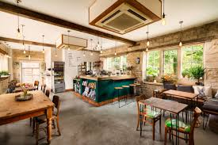
Final SQL Project - Family Owned Cafe
By:
Nadia Muhammed
Amena Bhingraj
Saara Hassan

Slide 2
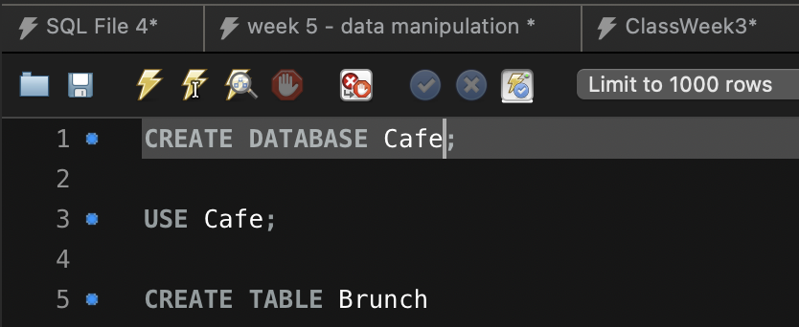
Create Database called CAFE, USE CAFE then created our first of five tables - BRUNCH

Slide 3
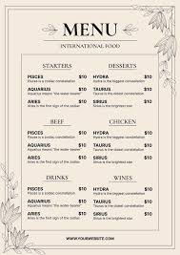
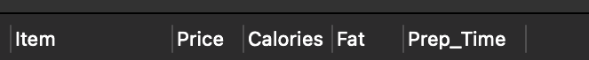
Insert these Columns in each of the 5 Tables:
CREATE TABLE “TABLE NAME”
(
Item VARCHAR(50),
Price DECIMAL(5, 2),
Calories INTEGER,
Fat INTEGER,
Prep_Time VARCHAR(10)
);

Slide 4
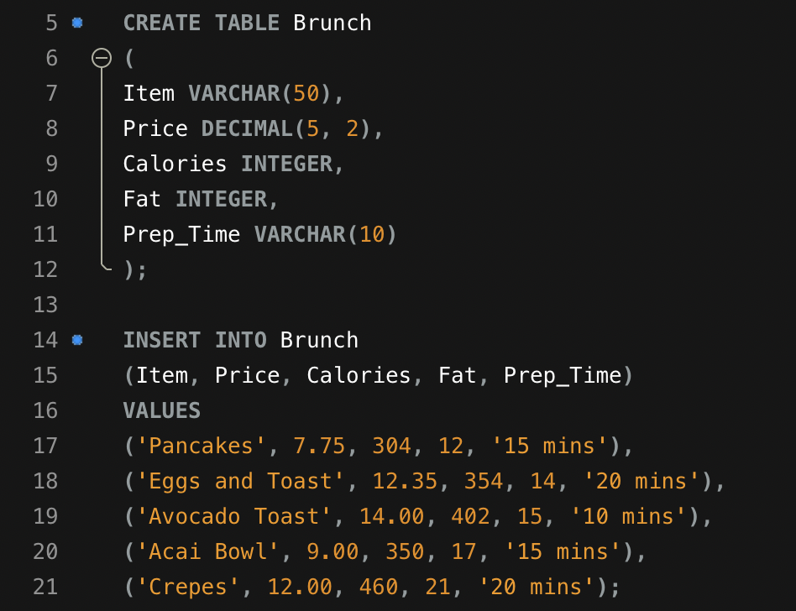
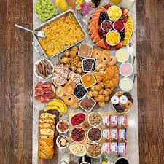
2. Created the BRUNCH table and then INSERT items into BRUNCH

Slide 5
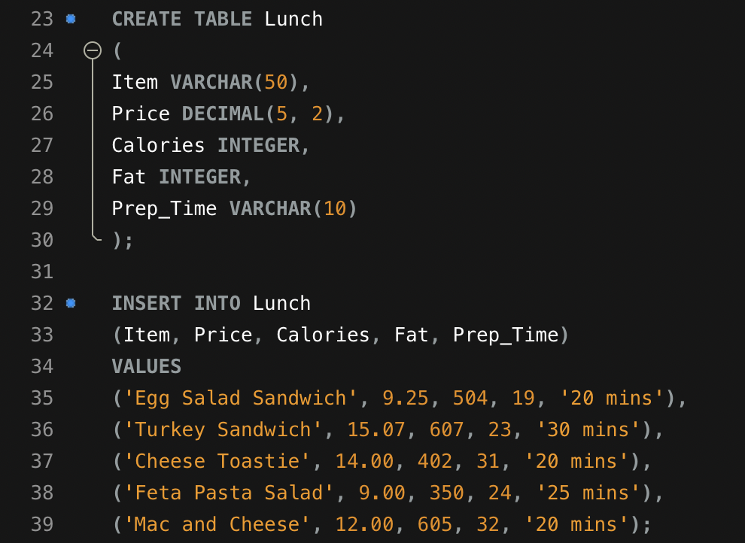
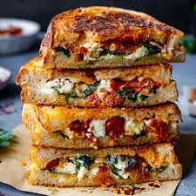
3. CREATE second table - LUNCH and INSERT items into LUNCH

Slide 6
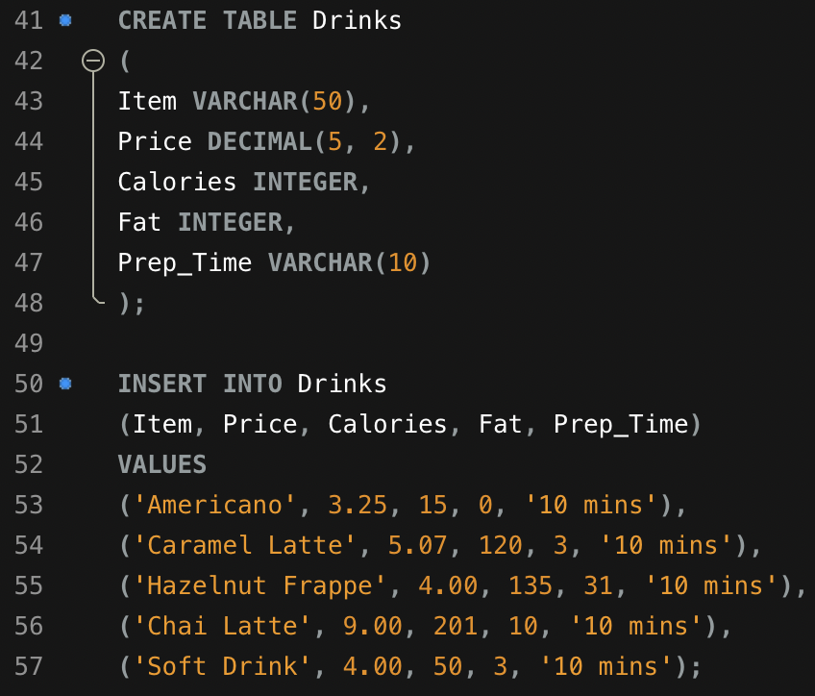

4. Created and inserts - DRINKS

Slide 7
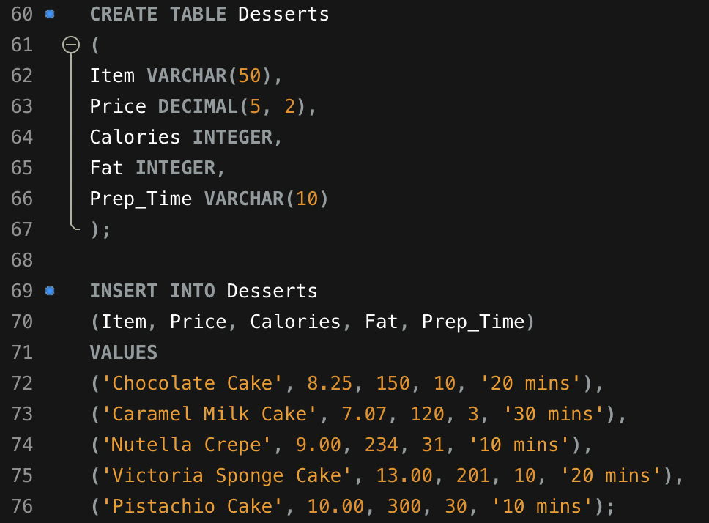
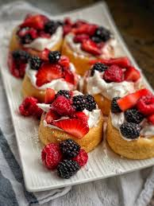
5. Created and inserts - DESSERTS

Slide 8
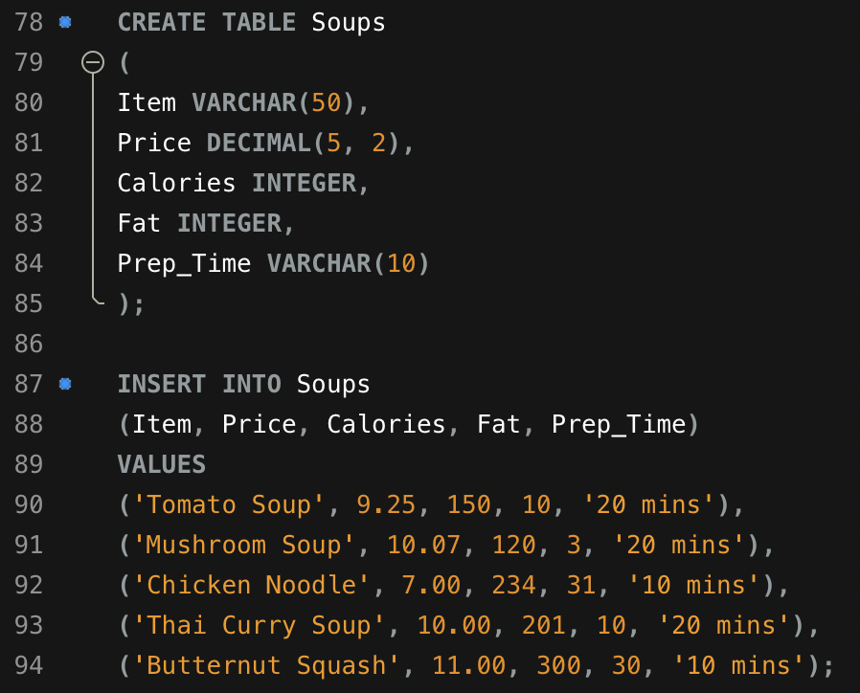
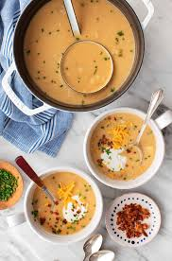
6. Created last table and inserts - SOUPS

Slide 9
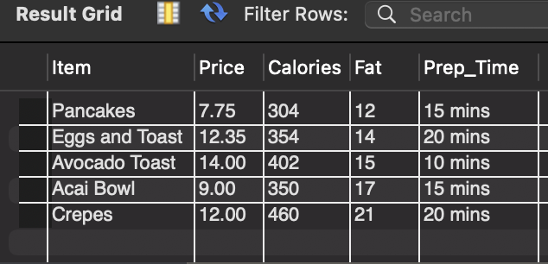
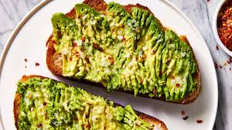
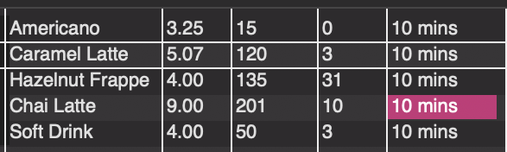
The 5 Tables Created So Far:

Slide 10
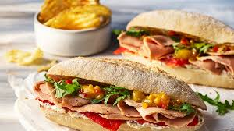
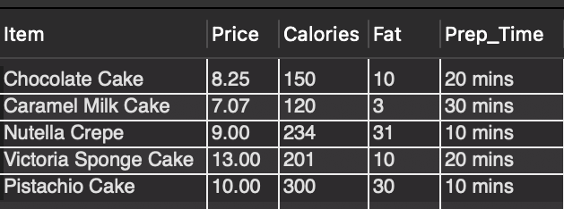
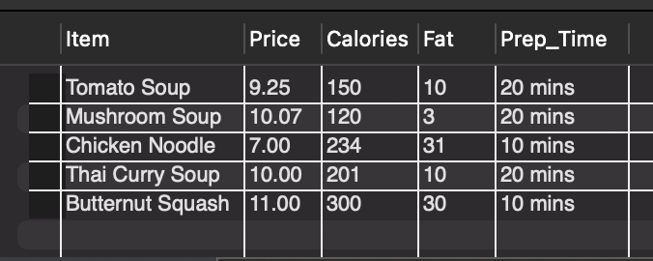
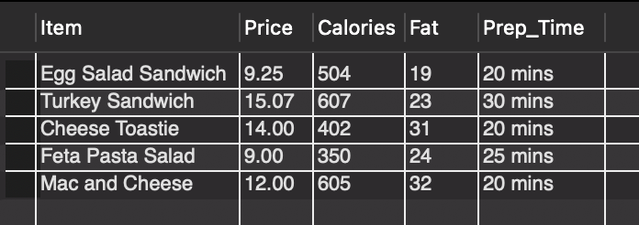
The 5 Tables Created So Far:

Slide 11
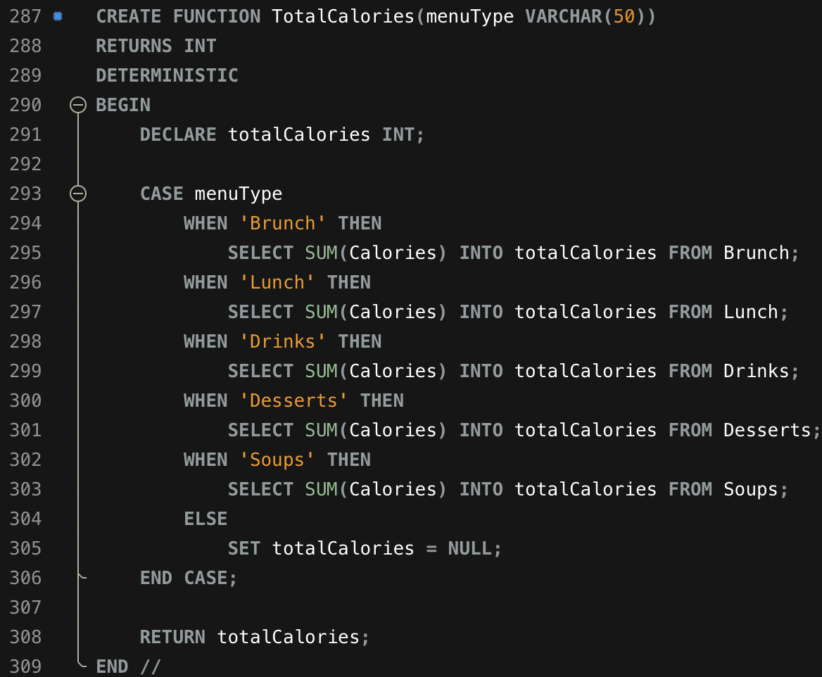
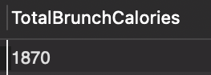



We Created the Stored Function -
DELIMITER to see all calories from the Menu Types
This shows the advanced technique to show how the data runs as well

Slide 12
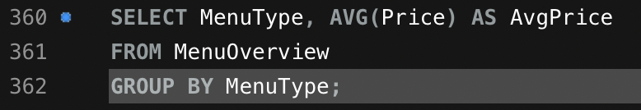
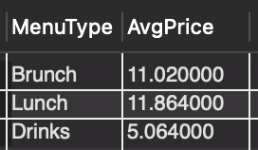
Example Query with a Subquery to Extract Ave Menu Price Data:

Slide 13
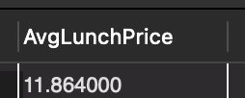
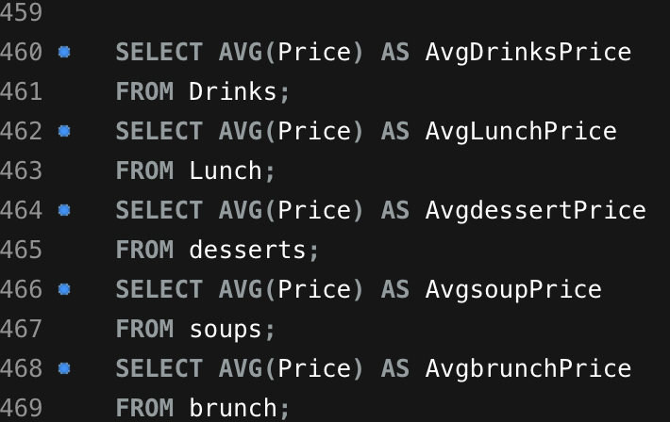



Another Example of Subquery of Avg Price:

Slide 14
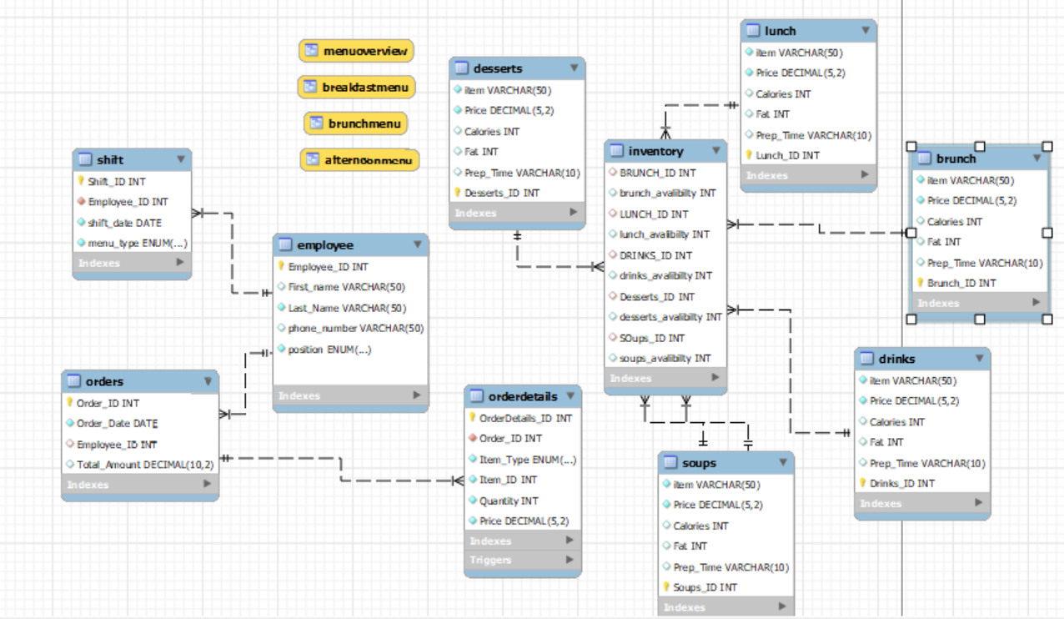
DB Diagram Where all Table Relations Are Shown:

Slide 15
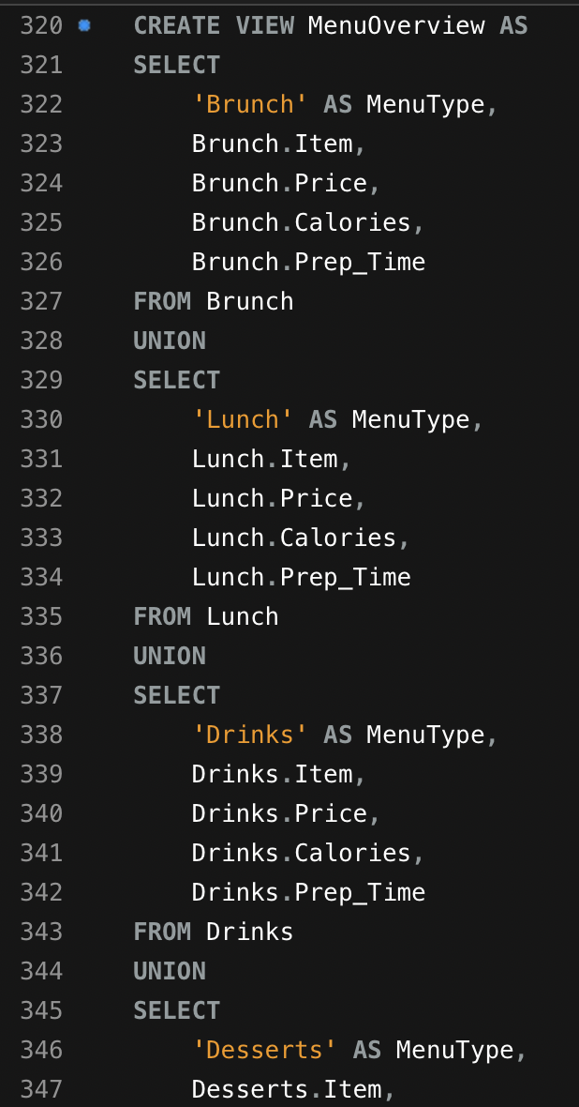
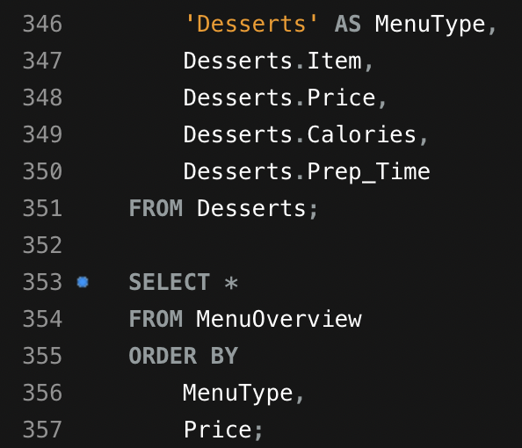
Created a view that uses at least 3-4 base tables;to produce a logically arranged result set for analysis:
We used Brunch, Drinks, Dessert

Slide 16
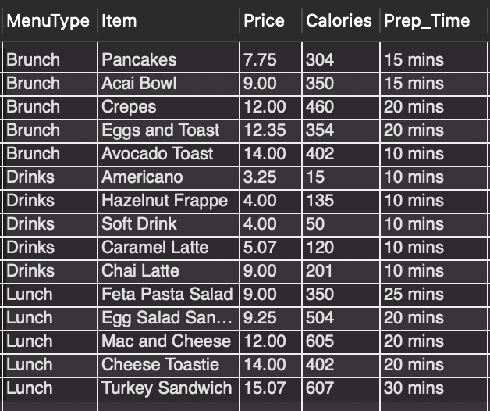
Here is the logically arranged (Brunch, Drinks, Lunch) result set

Slide 17
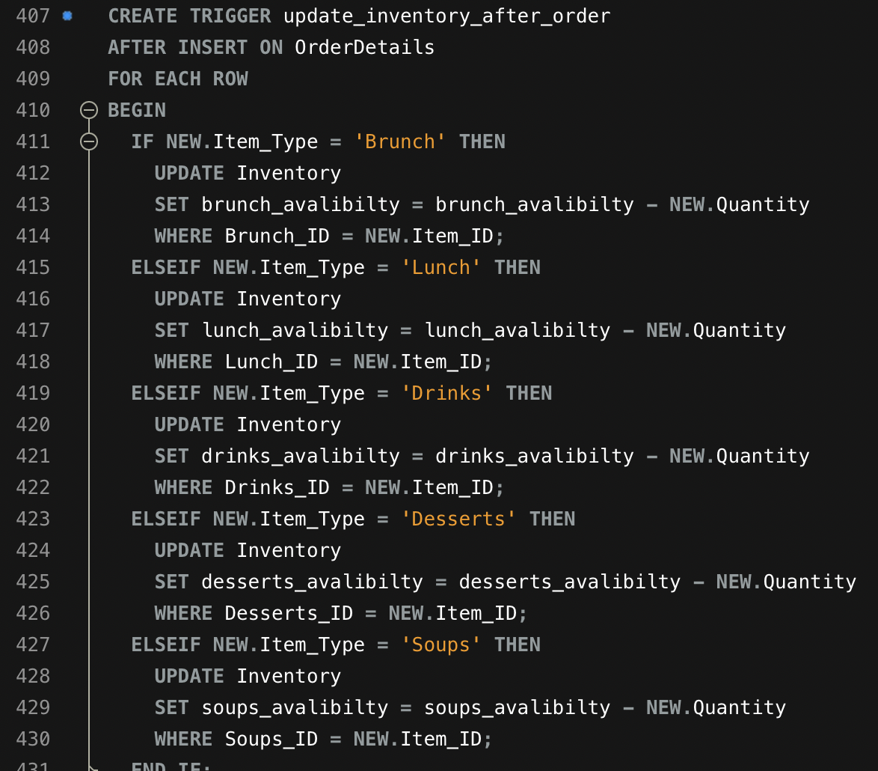
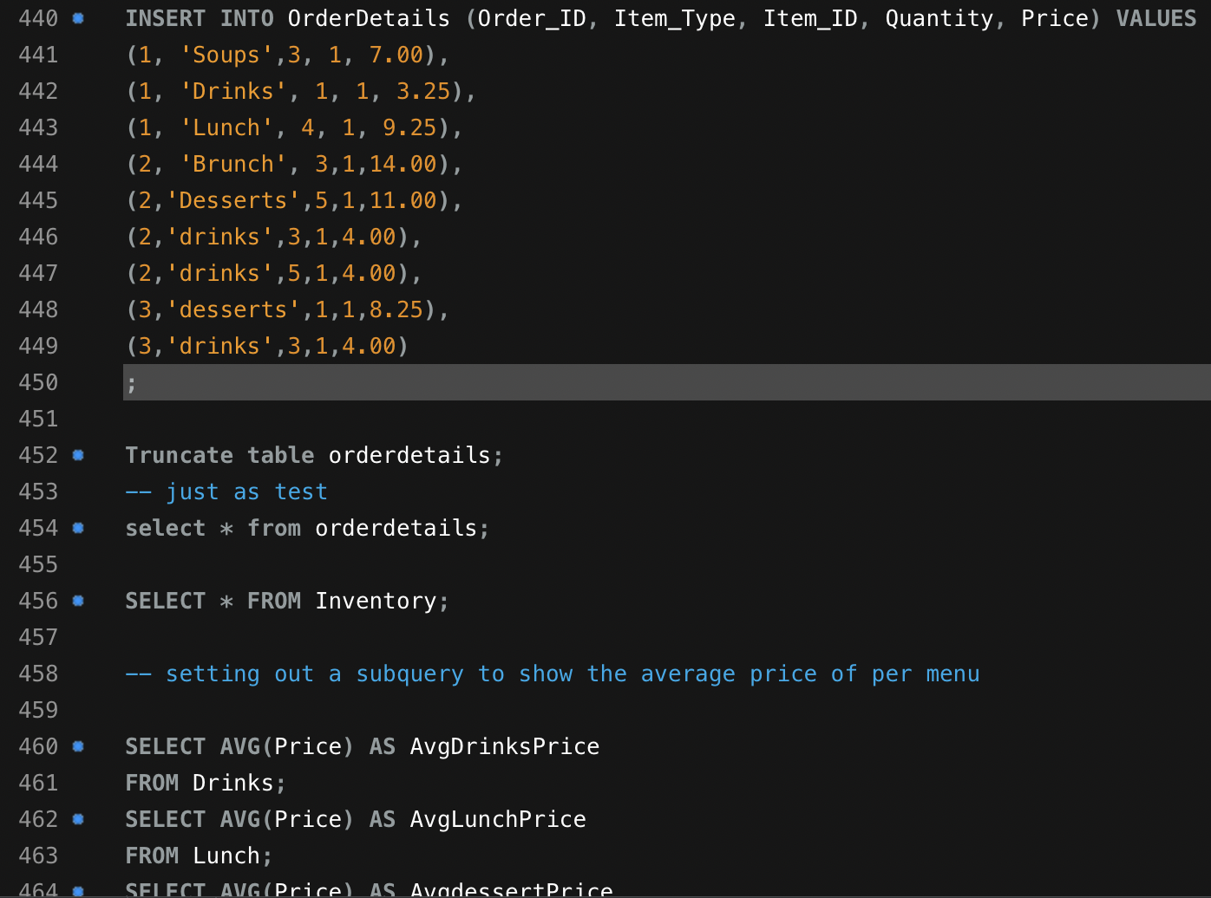
Created a Trigger for the Inventory

Slide 18
Skills Set Used in This Presentation:
CORE REQUIREMENTS
✔ Create relational DB of your choice with minimum 5 tables
✔ Set Primary and Foreign Key constraints to create relations
between the tables
✔ Using any type of the joins create a view that combines multiple tables in a logical way
✔ In your database, create a stored function that can be applied to a query in your DB
✔ Prepare an example query with a subquery to demonstrate how to extract data from your DB for analysis
✔ Create DB diagram where all table relations are shown
ADVANCED SKILLS:
✔ In your database, create a stored procedure and demonstrate how it runs
✔ In your database, create a trigger and demonstrate how it runs
✔ Create a view that uses at least 3-4 base tables; prepare and demonstrate a query that uses the view to produce a logically arranged result set for analysis.

Slide 19
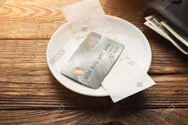
Thank You!

